Slide 1

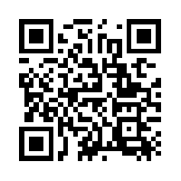
Quantum Communications Group
Weekly report
Group Coordinator:
Armando Nolasco Pinto
anp@ua.pt
Group Websites:
https://www.it.pt/Groups/Index/72
LinkedIn: https://www.linkedin.com/company/quantum-communications-group-it-av/

Slide 2
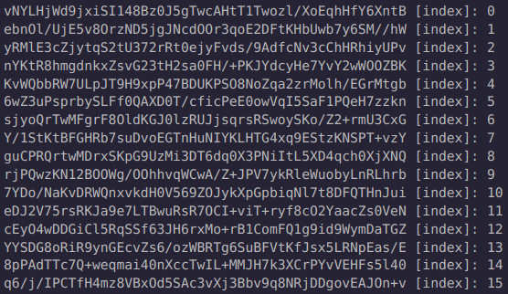
Saved keys
The KMS is saving keys with index, by type (symmetric / oblivious) and format (ASCII / b64)
KeyChunkSize: 50
Notes:
The KMS is saving keys with index, by type (symmetric/oblivious) and format (ASCII/b64)

Slide 3
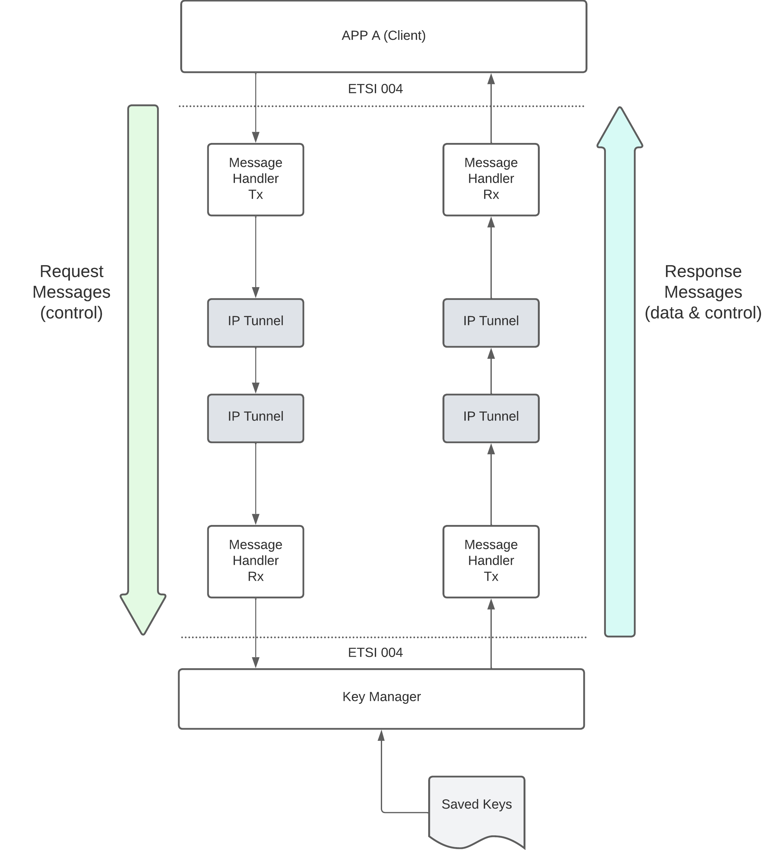
North Interface
North Interface present in KMS. Works as the South Interface but in Pull mode. It connects to an App and sends the keys requested by the App.

Slide 4
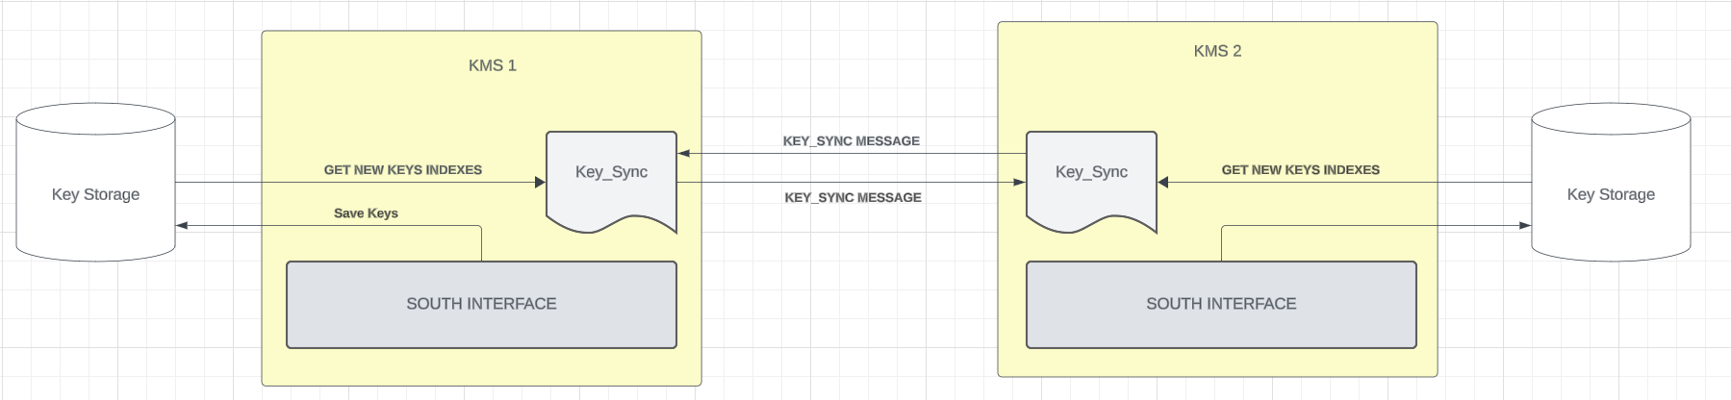
Key Synchronization Block
Key_Sync Message( URI &source, URI &destination, Status status, unsigned int index, QoS &qos){
{"command", "KEY_SYNC"}, {"data", { {"source", source}, {"destination", destination}, {"qos", { {"key_type", qos.key_type}, {"key_chunk_size", qos.key_chunk_size}, } }, }, }, {"status", status}, {"index", index},
};

